Slide 1
TRAINING DAY 2

Slide 2
AGENDA
BODS Transformations
Functions
Scripts
Questions

Slide 3

BODS Transforms
1. QUERY :
Retrieves a data set that satisfies conditions that you specify. This transform is similar to a SQL SELECT statement.
The Query transform can perform the following operations:
Choose (filter) the data to extract from sources.
Join data from multiple sources
Map columns from input to output schemas
Perform transformations and functions on the data
Perform data nesting and un-nesting
Add new columns, nested schemas, and function results to the output schema
Assign primary keys to output columns

Slide 4
Fig 1.1: Query transform

Slide 5

2. CASE :
The Case Transform is used to route one row to different outputs depending on conditions. Specifies multiple paths in a single transform (different rows are processed in different ways).
The Case transform simplifies branch logic in data flows by consolidating case or
decision making logic in one transform. Paths are defined in an expression table.
If we have to load location data to different tables we give: Consider 3 countries: IN, S, US
If LOCATION=IN then load the data into IN_EMP If LOCATION=SG then load the data into SG_EMP
If LOCATION=US then load the data into US_EMP
If LOCATION is other than IN,SG and US then load the data into OTHER_EMP

Slide 6
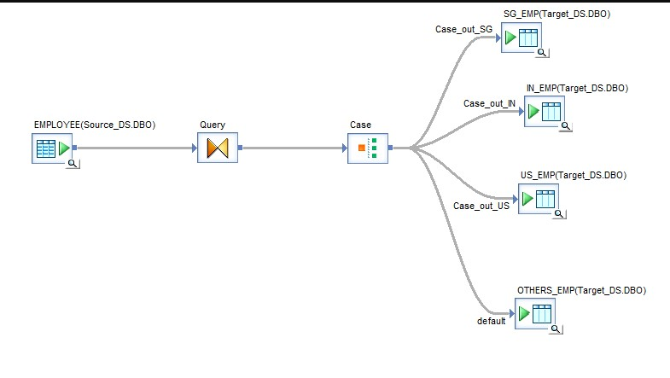
Fig 2.1: Case transform

Slide 7

3. DATA TRANSFER:
Data transfer transformation is used extensively to optimize the performance of the job by pushing down operations to the Database level or Operating system level or C
Data transfer transformation insures the operations for ‘push down’. This is performed by the underlying database instead of Data services engine if the transfer type is a database table.
Data transfer transformation creates a temporary Database table that is used as staging
table for operation, thus insuring the push down.
By pushing down operations to the source database, Data services reduce the no. of rows and operations that the engine must retrieve and process, which improves the performance.

Slide 8
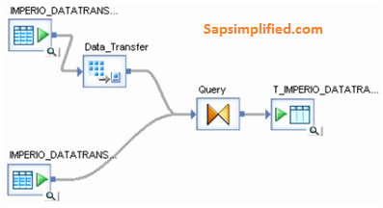
Fig 3.1: Data transfer transform

Slide 9
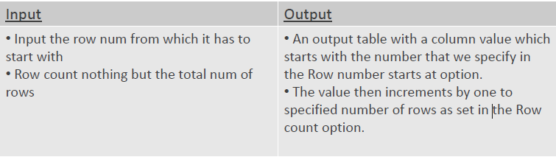
4. ROW GENERATION:
The Row Generation transform does nothing else than generating one row after the other
with one INTEGER column only.
Step 1 : Drag the row generation from the platform transform.
Step 2 : Drag the query and create temporary table.
Step 3 : Connect as in the picture and run the job.

Slide 10
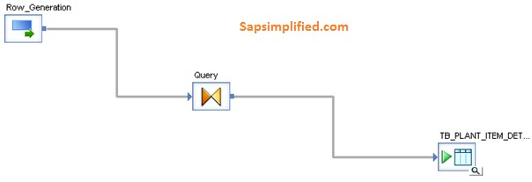
Fig 4.1: Row generation transform

Slide 11
5. Date generation:
This transform generates a column which holds the date values based on the start & end dates provided as an input to the transform by considering the increment provided to it.
Step 1 : Drag date generation transform from Local object library
Step 2 : Place query transform
Step 3 : Map date generation to query transform
Step 4 : Create a target table and connect from query
Step 5 : Run the job and see the output in target.

Slide 12
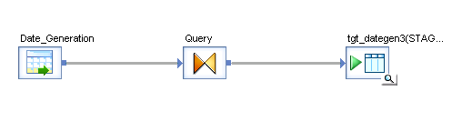
Fig 5.1: Date generation transform

Slide 13
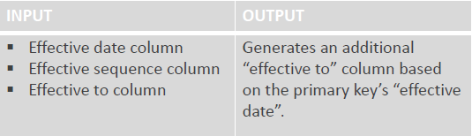
6. EFFECTIVE DATE:
Effective Date transformation defines validity of each and every record in a Time dependent table.
Step 1 : Drag a source table containing date column.
Step2 : Drag a effective date transform and connect it to source.
Step 3 : Run the job and check the target for effective to column.

Slide 14
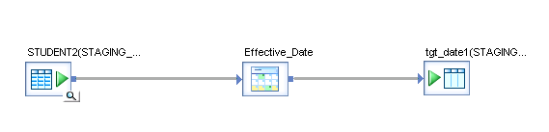
Fig 6.1: Effective date transform

Slide 15
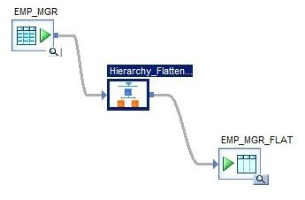
7. Hierarchy Flattening:
The hierarchy flattening transform can analyze a parent-child relationship and provide a description of the hierarchy in a flattened format (vertically flattened/ horizontally flattened). Each row in the output will contain 1 parent-child relationship.
Fig 6.1: Heirarchy flattening transform

Slide 16

8. XML Pipeline:
XML Pipeline is a readymade logic in the form of transform which helps to extract part of
XML data dynamically.
XML Pipeline transform supports only XML (nested structure) input dataset.
XML Pipeline transform converts Nested structure into Flat structure.
No multiple inputs are allowed with XML pipeline.
Input to the XML Pipeline transform must be a XML source, either DTD (Document Type Definition) or XSD (XML Schema Definition).
XML pipeline allows only level (part) of extraction, i.e. from one level, only a set of
columns of one node are allowed to extract.

Slide 17
For Example, A sample XSD file contains the structure of input XML source and is defined as input to XML pipeline transform.
Sample XML file which contains the data of input XML source. It is to be selected in the
Source editor properties.
From figure 8.1 it is clear that two XML Pipeline transforms are used to extract the data from input XML-XSD dataset.
Item and Ship-to (Delivery) are two nodes present at the same level in the given source.
Two XML Pipelines are used to extract fields from these two nodes.
A query transform is used to ‘join’ these two nodes to get a single flat output structure.

Slide 18
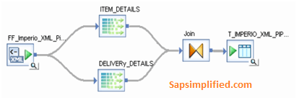
Fig 8.1: XML Pipeline transform

Slide 19

9.HISTORY PRESERVATION:
History preserving allows the data warehouse or data mart to maintain the history of data so you can analyze it over time. Most likely, you will perform history preservation on dimension tables.
For example, if a customer moves from one sales region to another, simply updating the customer record to reflect the new region would give you misleading results in an analysis by region over time because all purchases made by a customer before the move would incorrectly be attributed to the new region.
SAP Data Services provides a special transform that preserves data history to prevent this kind of situation. The History Preserving transform ignores everything but rows flagged as UPDATE. For these rows, it compares the values of specified columns and, if the values have changed, flags the row as INSERT. This produces a second row in the target instead of overwriting the first row.

Slide 20
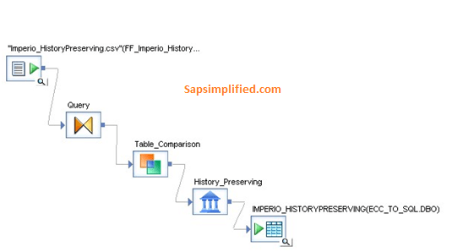
Fig 9.1: History Preserving transform

Slide 21
Step 1 : Drag source table from local object library
Step 2 : Drag query, Table comparison, History preserving and Table to be
Step 3 : Connect them in a sequence
Step 4 : Map query, table comparison, history preserving
Step 5 : Run the job and compare source and target tables.
compared

Slide 22

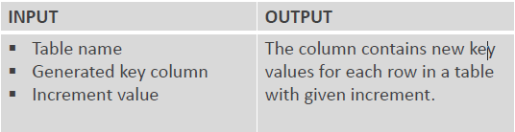
10. Key Generation:
Key Generation Transformation is used to generate artificial keys for new rows in a table.
The source table must be imported into the DS repository before defining the source table for this transform. The fully qualified Table name.

Slide 23
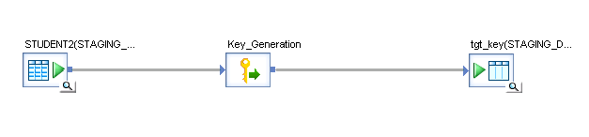
Fig 10.1: Key Generation transform
Step 1 : Drag a source table from local object library Step 2 : Map it to key generation transform.
Step 3 : Check the target table for key generated column.

Slide 24
11. Map_CDC_Operation:
Map CDC Operation is used to support relational or mainframe changed-data capture (CDC). This transform reads the source DML changes i.e. INSERT/UPDATE/DELETE and reflects the same in the target system. So the transform maps all the source rows logged as insert to an insert, all updates to update and the deletes to delete in the target table
Whenever a CDC based source table is imported in Data Services, it generates two more additional columns
namely DI_OPERATION_TYPE and DI_SEQUENCE_NUMBER.
The DI_OPERATION_TYPE column holds the corresponding database DML operation codes for insert,update & delete. Possible OP codes are I - Insert, B - Before Image of update, U - Update, D- Delete
The DI_SEQUENCE_NUMBER column holds the information of the order/sequence of the database DML operations. For example if we want to update or delete the row first and then insert it, it doesn't makes sense; Hence the execution order has to be maintained. The order of DML command execution is very important.

Slide 25

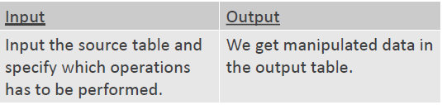
12. Map Operation:
Map Operation transform allows conversions between data manipulation like operations like
INSERT, UPDATE, DELETE & REJECT.
The ‘Map Operation’ transform allows you to change operation codes on data sets to produce the desired output. For example, if a row in the input data set has been updated in some previous operation in the data flow, you can use this transform to map the UPDATE operation to an INSERT. The result could be to convert UPDATE rows to INSERT rows to preserve the existing row in the target.

Slide 26
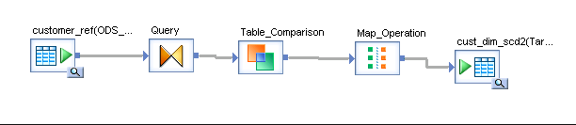
Fig 12.1: Map Operation transform
Step 1 : Drag the source table.
Step 2 : Place the query transform, table comparison and map operation icons.
Step 3 : Create temporary tables and make 1 table as permanent which behaves as the
output from table comparison.
Step 4 : Connect the other temporary table from map

Slide 27

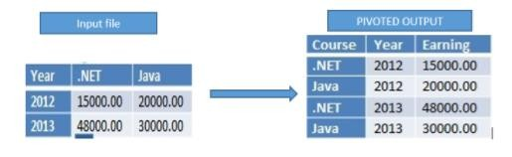
13. Pivot:
Pivot Transformation is used to Convert Column Values of table\file into Row Values.
This creates a new row for every value that you specify as a pivot column. Observe the icon, it says that it will convert column to rows.

Slide 28
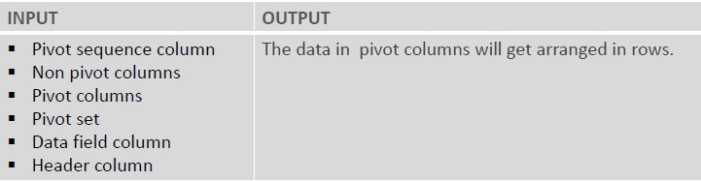
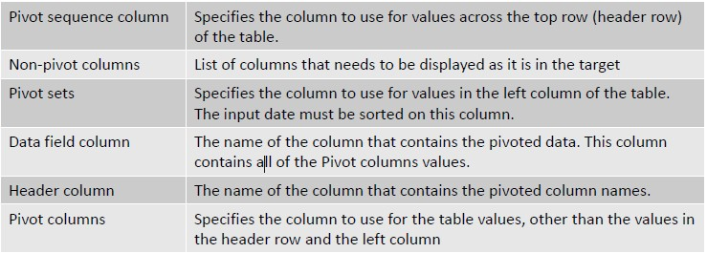

Slide 29
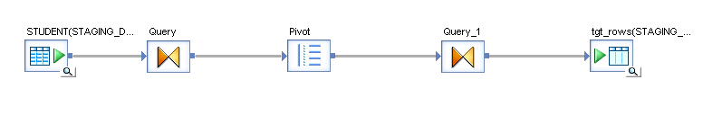
Fig 13.1: Pivot transform
Step 1 : Drag source table from local object library
Step 2 : Drag Query transforms, pivot transform and temporary table. Step 3 : Connect them in sequence and map
Step 4 : Check the pivoted column converted to row in target.

Slide 30

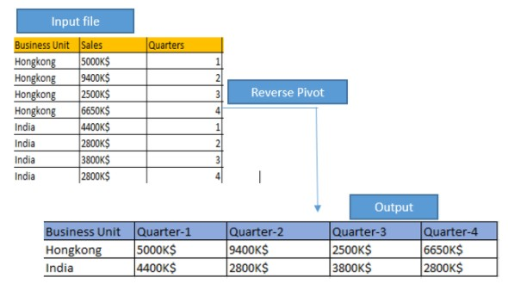
14. Reverse Pivot:
Reverse Pivot Transformation is used to Convert Rows Values of table\file in to Column Values. It creates a new column for every value that is specified as a pivoted column.

Slide 31
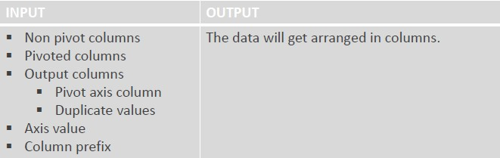
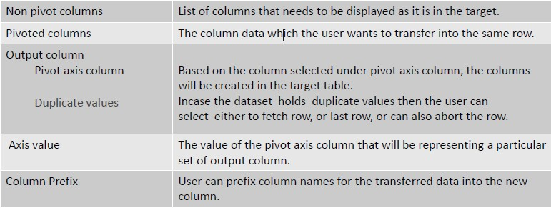

Slide 32
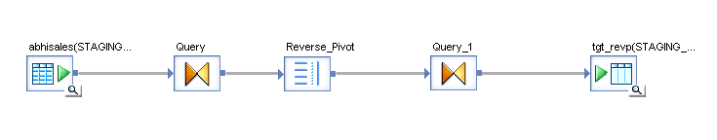
Fig 14.1: Reverse Pivot transform
Step 1 : Drag source table from local object library
Step 2 : Drag Query transforms, Reverse pivot transform and temporary table. Step 3 : Connect them in sequence and map
Step 4 : Check the row values converted into column values in the target.

Slide 33

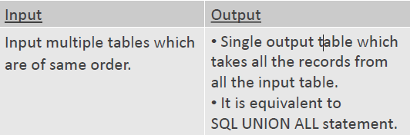
15. Merge:
Merge transform is basically used to combine multiple incoming data sets to produce a single output dataset with the same structure as that of the input data set.
It is equivalent to SQL UNION ALL statement. In order to eliminate duplicate records from output dataset basically to attain UNION operation, add a Query transform with DISTINCT option enabled after the Merge transform.
All the Input data sets must have same structure and data type lengths.

Slide 34
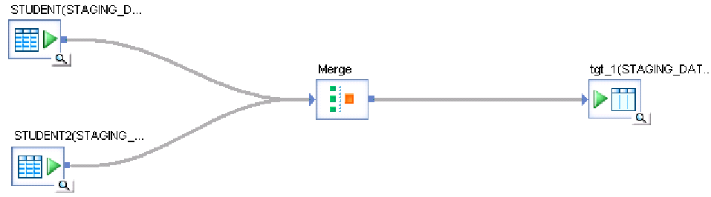
Fig 15.1: Merge transform
Step 1 : Drag multiple tables and make it as source tables.
Step 2 : Place merge transform and map it from the source tables.
Step 3 : Drag 1 temporary table and connect from

Slide 35

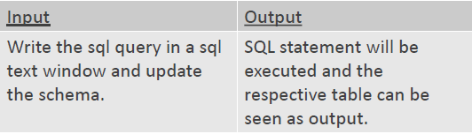
16. SQL Transform:
SQL transform is used to submit or perform standard SQL operations on database server. The
SQL transform supports a single SELECT statement only.
It supports only retrieval operations (select statements). Using SQL transformation we can’t manipulate (Insert, Delete, Update) the data.
SQL transformation and lookup function have done same operations. Performance of SQL transformation is very good compared to lookup function.
SQL transformation supports only tables not files or other sources in SQL text.

Slide 36
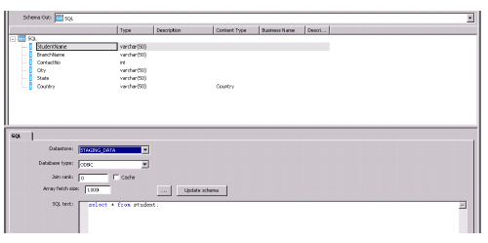
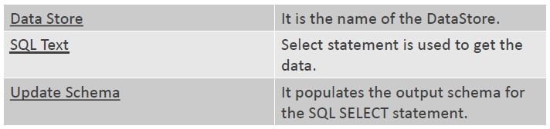

Slide 37
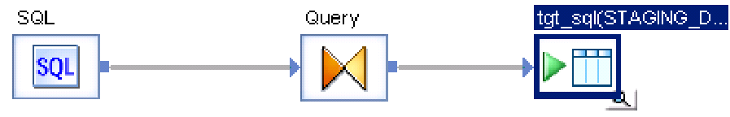
Fig 16.1: SQL transform
Step1 : Drag the SQL transform from platform transformation.
Step 2 : Place the query.
Step 3 : Create a temporary table and connect as shown in above picture.

Slide 38

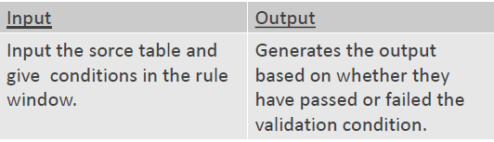
17. Validation Transform:
Validation transform is used to filter or replace the source dataset based on criteria or validation rules to produce desired output dataset.
This transform is used for NULL checking for mandatory fields, Pattern matching, existence of value in reference table, validate data type, etc.
The Validation transform can generate two output dataset Pass, Fail.

Slide 39
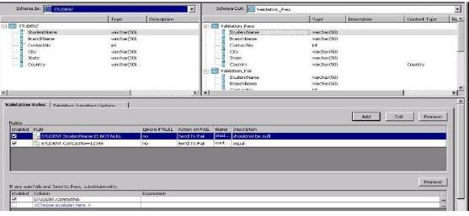
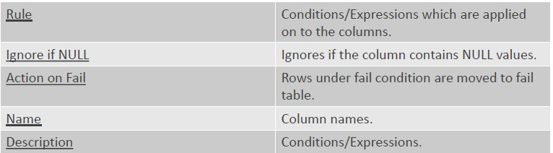

Slide 40
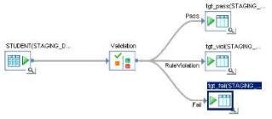
Fig 17.1: Validation transform
Step 1 : Drag the source table ,place the validation transform and connect it.
Step 2 : Create temporary tables for all the pass, fail and rule violation cases.
Step 3 : connect as shown and run the job.

Slide 41
Functions
In Data Services, functions take input values and produce a return value.
Some functions can produce the same or similar values as transforms.
However, functions and transforms operate in a different scope:
Functions operate on single values, such as values in specific columns in a data set.
Transforms operate on data sets, creating, updating, and deleting rows of data.
You can use functions in the following:
Transforms (Query, Case, SQL)
Script objects
Conditionals
Other custom functions

Slide 42
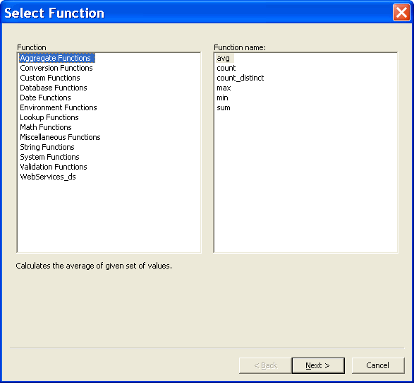
1.Pre-defined Functions:
These are the functions defined in the SAP Data service. Like every tool provides some
in-built functions, SAP Data service too provide some predefined functions.

Slide 43
These functions are basically classified into 14 different categories as listed below:
Aggregate Functions
Conversion Functions
Cryptographic Functions
Custom Functions
Database Functions
Date Functions
Environment Functions
Lookup Functions
Math Functions
Miscellaneous Functions
SAP Functions
String Functions
System Functions
Validation Functions

Slide 44
Some in built functions are:
add_months(original_date, months_to_add)
avg(value_list)
day_in_month(date1)
day_in_year(date1)
exec(command_file, parameter_list, flag)
get_error_filename()
job_name()
job_run_id()
key_generation(table, key_column, key_increment)
lookup ()
lookup_ext()
raise_exception()
sysdate()
wait_for_file()

Slide 45
2. Custom Defined Functions:
You can create your own functions by writing script functions in SAP BusinessObjects Data Services scripting language using the smart editor.
Consider these guidelines when you create your own functions:
Functions can call other functions.
Functions cannot call themselves.
Functions cannot participate in a cycle of recursive calls. For example, function A cannot
call function B, which calls function A.
Functions return a value.
Functions can have parameters for input, output, or both. However, data flows cannot pass
parameters of type output or input/output.

Slide 46
To create a custom function:
Choose Tools > Custom Functions.
In the Custom Function list, right-click and select New.
Enter the name of the new function.
Enter a description for your function.
Click Next to open the smart editor.
In the Variables tab, right-click Return and select Properties...
In the Variables tab, right-click Parameters and choose Insert.
Define parameter properties by choosing a Data type and a Parameter type (Input, Output, or
Input / Output) and Click OK.
To define variables used by the function, but not passed outside the function, right-click Local and choose Insert.
Choose a data type in the Variable Properties window and click OK.
Complete the text for your function and click OK.

Slide 47
Scripts
Scripts are single-use objects used to call functions and assign values to variables in a work flow.
For example, you can use the SQL function in a script to determine the most recent update time for a table and then assign that value to a variable.
You can then assign the variable to a parameter that passes into a data flow and
identifies the rows to extract from a source.
A script can contain the following statements:
Function calls
If statements
While statements
Assignment statements
Operators
Each line ends with a semicolon ‘;’

Slide 48
THANK YOU

